Slide 1

Amazon Rating , Review & Discount Analysis MIRCOSOFT Excel
Notes:
Line spacing + Page numbers

Slide 2



Introduction
01
In this project, we will be using Microsoft Excel to analyze the supermarket sales dataset. We will perform data cleaning, preprocessing, and exploratory data analysis to understand
the patterns and trends in the data. We will also create visualizations and reports to
present the data and gain insights

Slide 3
Project Goal
Analyzing the trend
Determining popular product
Understanding impact of discount
Identifying Valuable Customers
Analyzing Customer Ratings

Slide 4
Project Plans
Connect
Connect the database for retrieval of data
Clean
Removing Nulls and Nans
Pre-Process
Handle Missing Values
Analyze
Gain insights on the data provided
Analyze
Create Imagery & Animations
1
2
3
4
5

Slide 5
Data Overview
02

Slide 6
Column Names
Data Types
Product ID
Product Name
Category
Discounted Prices
Actual Price
Discount Percentage
Rating
Rating Count
About Product
User Id
User Name
Text
Text
Text
Fixed Decimal
Fixed Decimal
Percentage
Fixed Decimal
Text
Text
Text

Slide 7
Types of Charts used
Bar Chart
Column Chart
Pie
Area Chart
Line Chart

Slide 8
Dashboard Representation
04

Slide 9
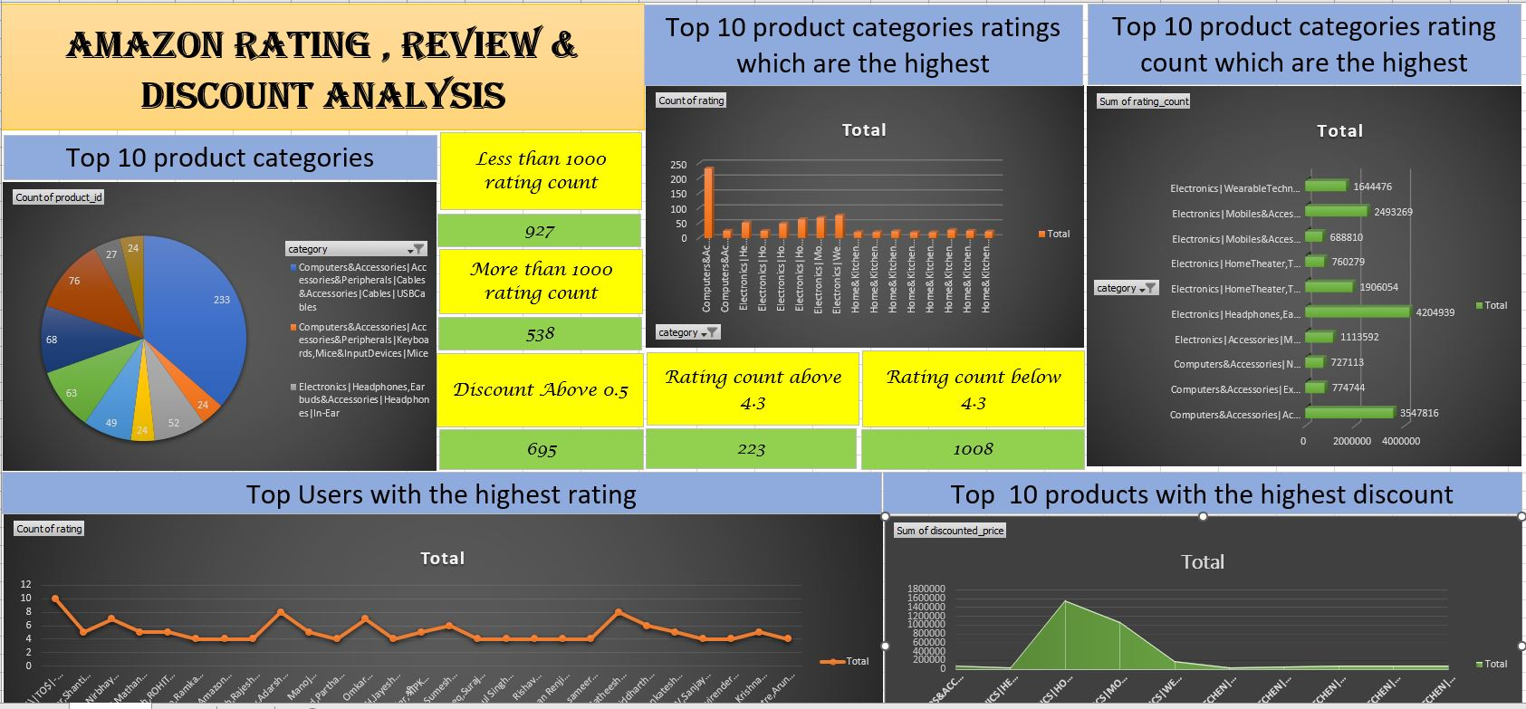
Dashboard Representation

Slide 10
Summary
This analysis on the supermarket sales data gives us the insight about all the customers belonging from different cities like the product lines ,quantity of product they are interested in buying . This in-depth analysis help us understand the sales trend & customer behavior. we can gain insights into which products are selling the most, what factors influence sales, and which customers are the most valuable

Slide 11

Thank You
05

